Slide 1
Hand Written Digit Recognition
RAGHAV V-210701203
RAGAVENDAR K-210701202

Slide 2


Agenda
A
Abstract
Introduction
Existing System
Proposed System
Architecture Diagram
Module Description
Output Screenshots
Conclusion and Future Works
Reference

Slide 3
Abstract
To build a model which can identify the handwritten digits by Recognition and classify them.
Humans can see and visually sense the world around them by using their eyes and brains.
Computer vision works on enabling computers to see and process images in the same way that human vision does.
Several algorithms developed in the area of computer vision to recognize images.
The goal of our work will be to create a model that will be able to identify and determine the handwritten digit from its image with better accuracy.
Aim to complete this by using the concepts of Convolutional Neural Network. Through this work, Aim to learn and practically apply the concepts of Convolutional Neural Networks.

Slide 4
Introduction

Slide 5
In the current age of digitization, handwriting recognition plays an important role in information processing.
There is a lot of information available on paper and less processing of digital files than the processing of traditional paper files.
The purpose of the handwriting recognition system is to convert handwritten letters into machine-readable formats.
Major applications include vehicle licence-plate identification, postal paper-sorting services, historical document preservation in the check truncation system (CTS) scanning and archaeology departments, old document automation in libraries and banks, and more.

Slide 6
Existing System

Slide 7
SVM algorithm is not suitable for large data sets.
SVM does not perform very well when the data set has more noise i.e. target classes are overlapping.
In cases where the number of features for each data point exceeds the number of training data samples, the SVM will underperform.
As the support vector classifier works by putting data points, above and below the classifying hyperplane there is no probabilistic explanation for the classification

Slide 8
Proposed System

Slide 9
A convolutional neural network (CNN) is a type of artificial neural network used in image recognition and processing that is specifically designed to process pixel data.
A convolutional neural network consists of an input layer, hidden layers and an output layer.
In any feed-forward neural network, any middle layers are called hidden because their inputs and outputs are masked by the activation function and final convolution.
In a convolutional neural network, the hidden layers include layers that perform convolutions.
Typically this includes a layer that performs a dot product of the convolution kernel with the layer's input matrix.
This product is usually the Frobenius inner product, and its activation function is commonly ReLU.

Slide 10
Architecture Diagram

Slide 11
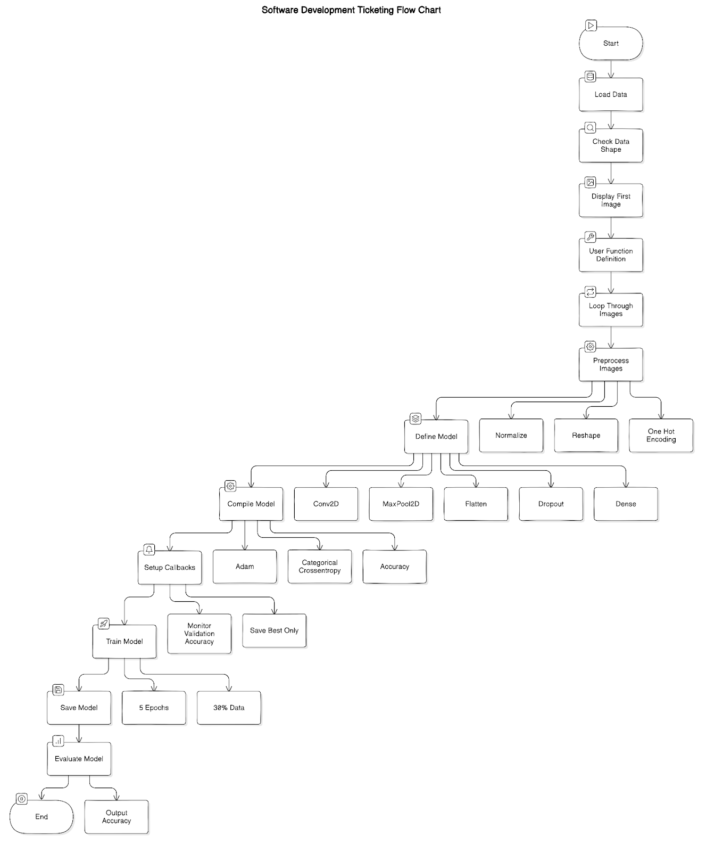

Slide 12
Module Description

Slide 13
1. Hand-Written Images
It is understood that a hand-written dataset is commonly used in computer analysis model evaluations such as machine learning and deep learning.
Many model classifiers mostly use the digit groups.
Other researchers are however accountable for the alphabet set of groups to display strength and scalability.
The research model deals with the description, the fundamental aspects, and algorithm processes, of classification tasks in slightly different ways

Slide 14
2. Hand-Written Datasets
It is understood that a hand-written dataset is commonly used in computer analysis model evaluations such as machine learning and deep learning.
Many model classifiers mostly use the digit groups.
Other researchers are however accountable for the alphabet set of groups to display strength and scalability.
The research model deals with the description, the fundamental aspects, and algorithm processes, of classification tasks in slightly different ways

Slide 15
3. Image Processing
The first step is MNIST dataset is generated and broken down into two different preprocessed datasets.
The first preprocessed database is a regular gray-scale, and the second preprocessed dataset is a binary gray-scale .
These two methods of preprocessing have been selected because they make it possible to translate the dataset to a low figure while maintaining its aspect ratio .

Slide 16
4. Image Segmentation
Segmentation is a process in the picture which extracts individual characters.
Two ways of segmentation occur.
They are Segmentation Implicit and Segmentation Explicit.

Slide 17
5. Feature Extraction
This is the essential step of the method of recognition, and the recognition algorithm begins from it as well.
Each character includes features of its own.
It involves a series of laws in which each law defines a behavior's character.
In this step, the extraction of certain features is completed

Slide 18
6.Deep Learning Models
Convolutional layers
Pooling Layers
Dropout Layers
Flatten and Dense Layers

Slide 19
Output Screenshots

Slide 20
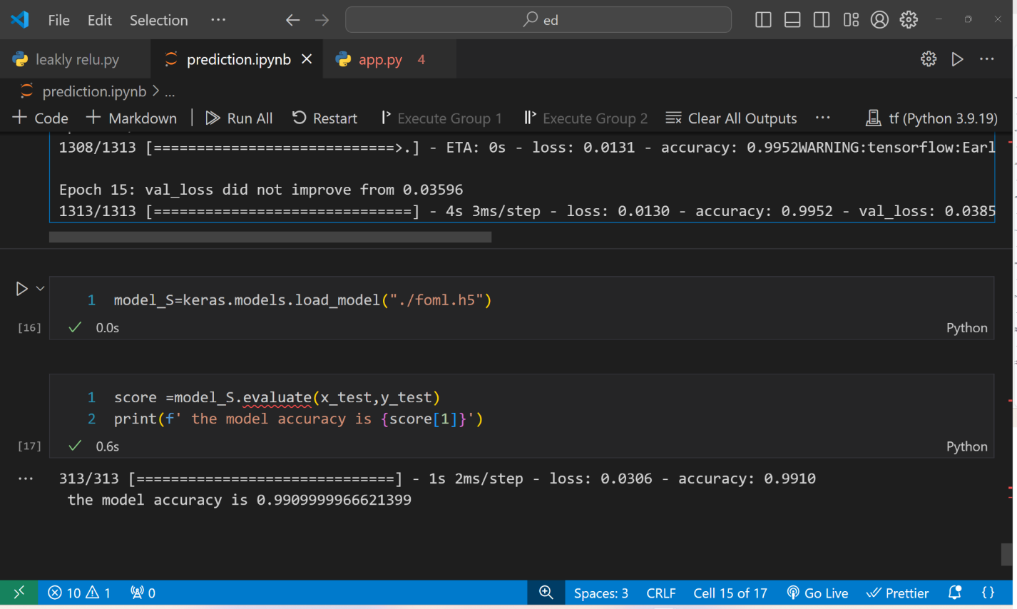
Model Evaluation

Slide 21
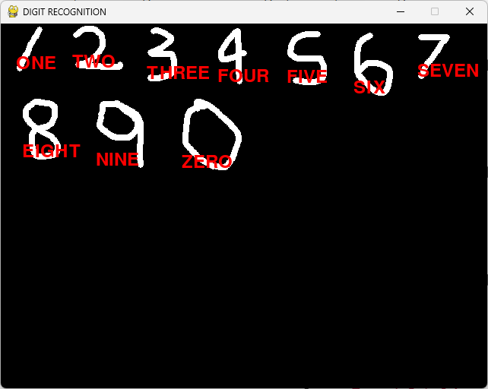
Result

Slide 22
Conclusion and Future Works

Slide 23
Conclusion
A dataset is divided into training and test dataset.
Here considered 80% data for training and 20% data for testing. It means that over all 1000 Images from that took 800 for training and 200 images for testing.
A dataset was taken to make predictions of handwritten digits from 0 to 9.
The dataset was cleaned, scaled, and shaped.
Using TensorFlow, a CNN model was created and was eventually trained on the training dataset.
Finally, predictions were made using the trained model with an accuracy 92.5%.In this successfully predicted all digits from 0 to 9.

Slide 24
Future Works
Plan to achieve better accuracy results on the coloured images also as there can be various boundary conditions that may exist in coloured images.
Also try to implement our models on letters and a double-digit(s) database so that can extend our implementation and can diversify our model’s application.
In future look forward to working with Double Digit and Triple Digit Numbers and also will plan to predict characters also.

Slide 25
References

Slide 26
[1] M. Z. Alom, P. Sidike, T. M. Taha, and V. K. Asari, “Handwritten Bangla Digit Recognition Using Deep Learning,” vol. 6, no. 7, pp. 990–997, 2017.
[2] S. Majumder, “Handwritten Digit Recognition by Elastic Matching,” J. Comput., vol. 4, no. 04, pp. 1067–1074, 2018.
[3] G. Cheedella, “Critique of Various Algorithms for Handwritten Digit Recognition Using Azure ML Studio,” Glob. J. Comput. Sci. Technol., vol. 20, no. 1, pp. 1–5, 2020.
[4] S. M. Shamim, M. B. A. Miah, A. Sarker, M. Rana, and A. Al Jobair, “Handwritten digit recognition using machine learning algorithms,” Indones. J. Sci. Technol., vol. 3, no. 1, pp. 29–39, 2018.
[5] Y. Lecun, L. Bottou, Y. Bengio, and P. Ha, “LeNet,” Proc. IEEE, no. November, pp. 1–46, 1998.

Slide 27
Thank you

